Slide 1

Spell the tea
Project with strings

Slide 2
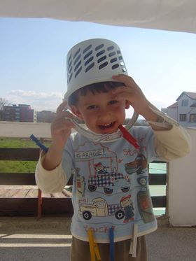
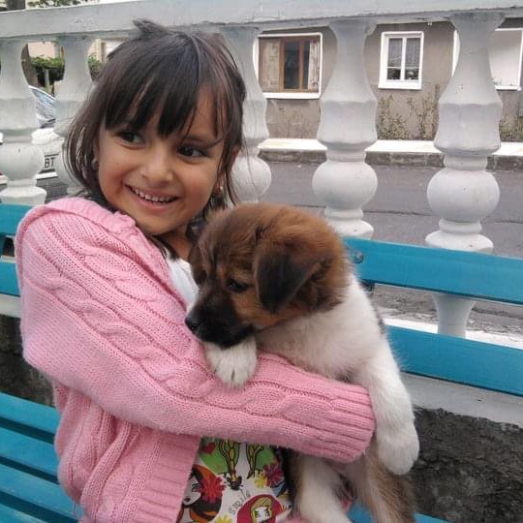
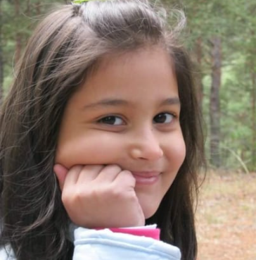
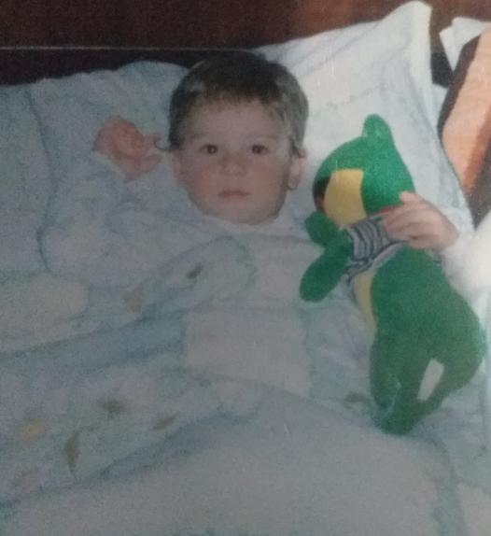
Our team
Bozhidar Dimitrov
Radina Velichkova
Nevena Pavlova
Radoslav Stoychev

Slide 3





The Problem
Our Topic
Brainstorming
Roles separating
Research
Realization

Slide 4
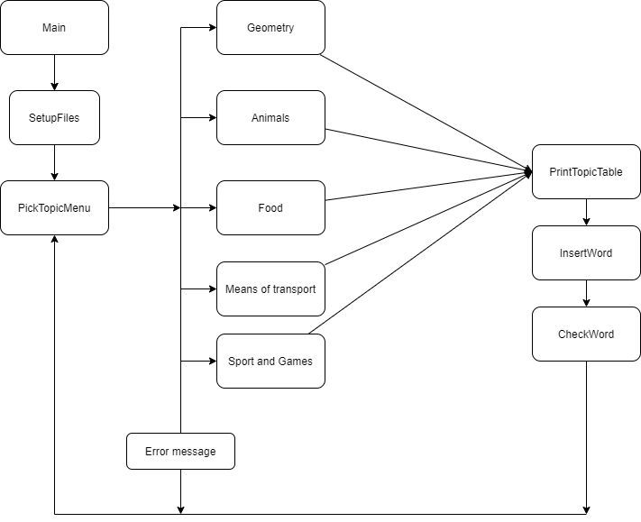
DIAGRAM for our program

Slide 5
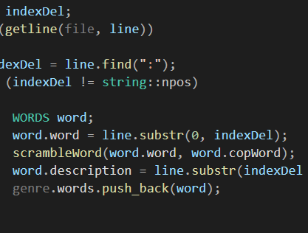
The functions and files that we used

Slide 6





USED TECHNOLOGIES

Slide 7

NOW IT'S TIME FOR OUR PROGRAM

Slide 8
